Slide 1
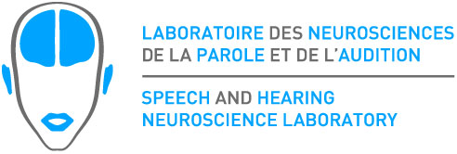
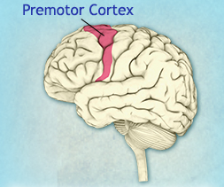
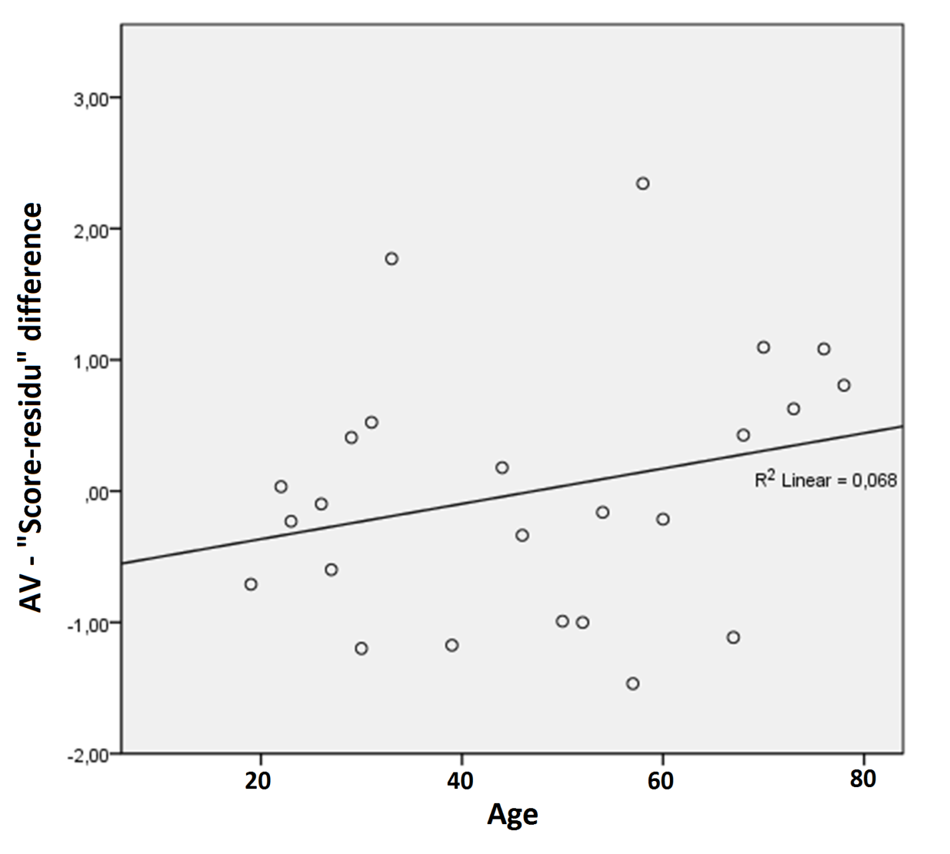
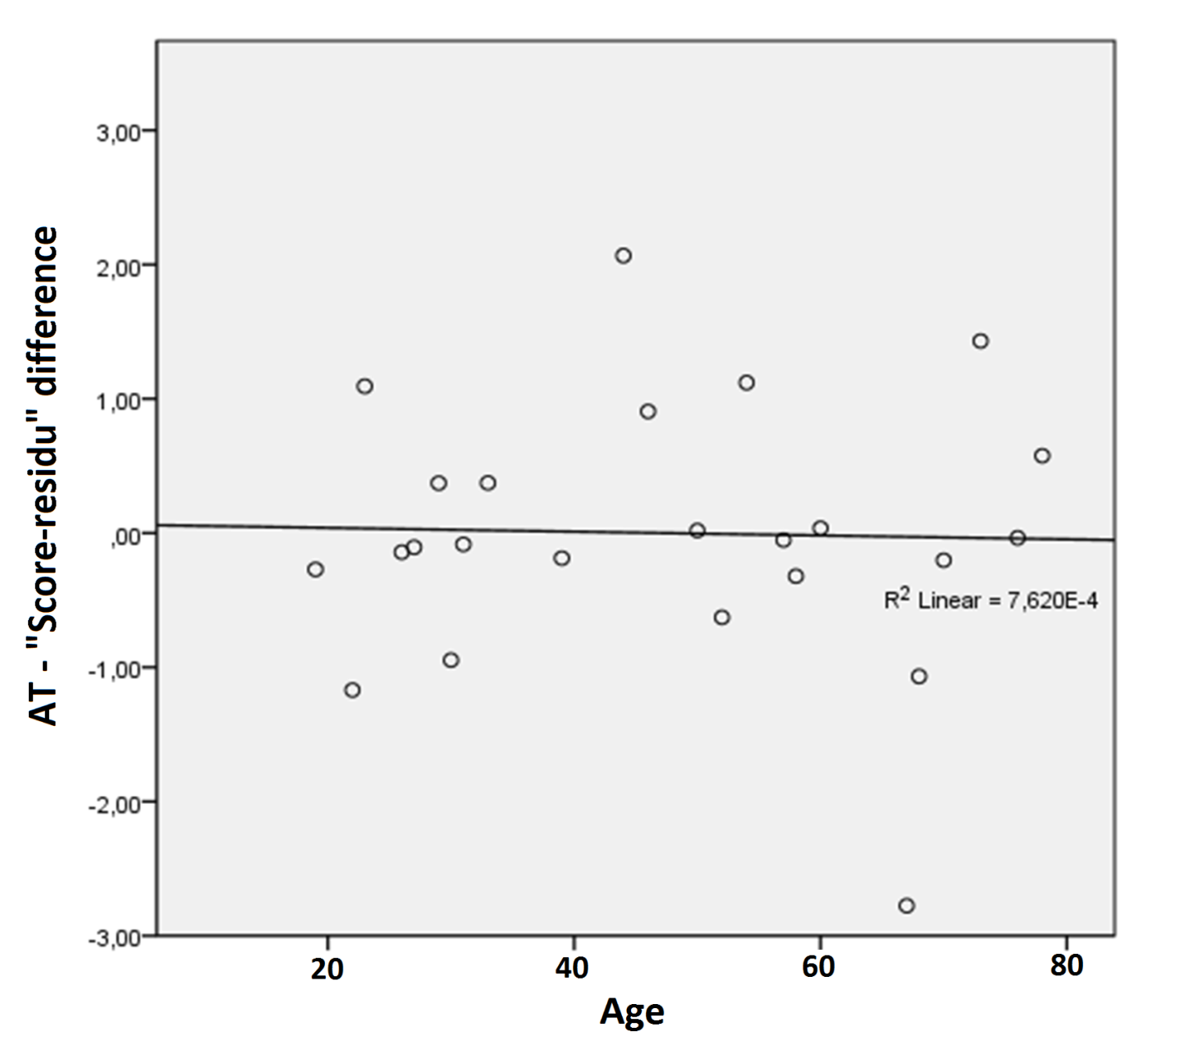
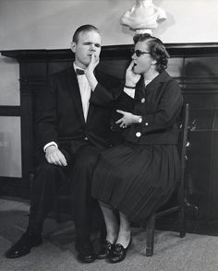
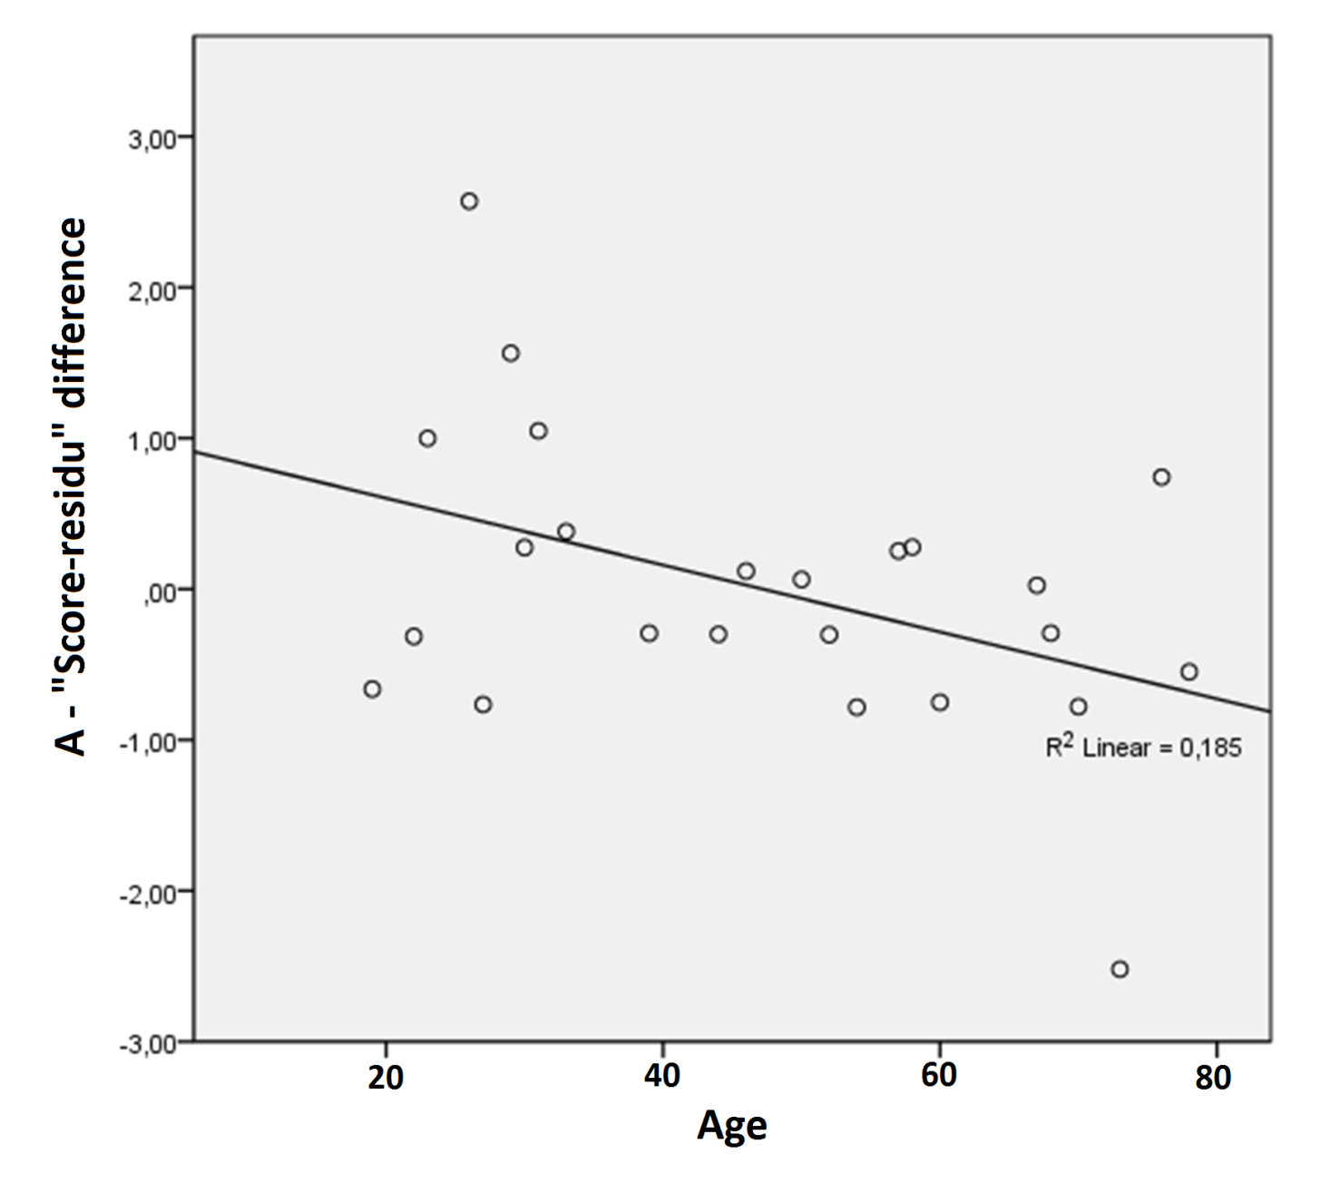
The role of the premotor cortex in multisensory speech perception
throughout adulthood: a rTMS study
Avril Treille¹, Marc Sato², Jean-Luc Schwartz¹, Coriandre Vilain¹ and Pascale Tremblay³
¹ GIPSA-lab, Department of Speech and Cognition, CNRS & Grenoble University, France
²Speech and Language Laboratory, CNRS & Aix-Marseille University, France
³ Centre de recherche de l’institut en santé mentale de Québec, Département de réadaptation, Université Laval, Québec City, QC, Canada
INTRODUCTION
RESULTS
SCIENTIFIC CONTEXT
The underlying debate: Is the motor system involved during multisensory integration mechanisms in speech perception?
1) Preservation of multisensorial integration mechanisms
3) Interaction between stimulation order and target region
SHORT LITERATURE
1) a- Speech is multisensorial : we simultaneously perceive speech via sounds (i.e., a speaker's utterance) and visual cues (i.e., a speaker's articulatory movements and facial expressions).
b- Interestingly, we can also perceive speech via the tactile modality [1] (i.e., touching the interlocutor’s face during production).
2) The premotor cortex (PMv) is involved in speech perception mechanisms, especially in adverse/complex situations, and more activated in audio-visual integration.
3) Aging provides a good model for studying the role of the PMv, because of the natural decline in sensory acuity that occurs with aging.
**
First:
No difference between left and right PMv
➔ New task, participants are slower / no TMS effect (= no or lower PMv recruitment ?)
Second:
Right PMv : faster RT than first session
Learning effect and/or not TMS sensitive
Left PMv: no significant RT difference with first session
➔ Left PMv impacted by TMS
AV: no difference of RT between letf and right PMv across age
➔ AV integration perserved
NS
OBJECTIVES AND HYPOTHESES
➔Determine the role of the right and left PMv in unimodal and multimodal speech processes and the contribution of the hemispheric differentiation in these processes in aging
Hyp 1: Left PMv more impacted by rTMS …
Hyp 2: … especially during audio-tactile condition (unfamiliar information) …
Hyp 3: … and stronger effect with age (compensatory mechanism).
AT: no difference of RT between letf and right PMv across age
➔ AT integration is possible
DISCUSSION
METHOD
1) Multimodal integration is relatively preserved in aging, becoming slower but not less accurate
2) Age-related reduction in hemispheric asymmetry in the motor system (consistent with the HAROLD model of neurocognitive aging, in which increased laterality is associated with age-related compensation [2])
Together, these results demonstrate that multisensory integration mechanisms are, at least in part, maintained with age despite a decline in auditory acuity, probably thanks to a more bilateral recruitment of the premotor cortex as a compensatory mechanism
These results also demonstrate the feasibility of using rTMS in healthy elderly adults to study speech and language processes.
PARTICIPANTS
24 healthy right-handed participants (16 females; mean 46±19 [19-78] years)
TASK
Force-choice identification task:
/pa/, /ta/ or /ka/ syllables in 5 different sensory modalities (A, V, AV, T, AT).
TADOMA method was used to test tactile modality.
Noise added in one condition (contrasted to a silent condition).
2) Greater recruitment of the right PMv to compensate the decline of auditory acuity during auditory speech perception in older adults
TADOMA method
TMS PROCEDURE
MRI session (to localize M1 and left and right PMv) then 2 rTMS sessions (left and right PMv) separated by 1 hour, and each one was followed by the behavioral task
900 pulses, 1 Hz, 115 % of passive motor threshold
rTMS
Task
Break
+ questionnaires
rTMS
Task
Bibliography:
[1] Treille et al. (2014). Haptic and visual information speed up the neural processing of auditory speech in live dyadic interactions. Neuropsychologia, 57: 71-77.
[2] Cabeza (2002). Hemispheric Asymetry Reduction in Older Adults : The HAROLD Model. Psychology and aging. 17: 85-100.
Aknowledgement: This study was supported by research funds from the European Research Council to J-L.S., by a grant from la Région Rhône-Alpes to A.T., and by an infrastructure grant from the Canadian Foundation for Innovation, to P.T., who also holds a Career Awards from the “Fonds de Recherche du Québec- Santé” (FRQS).
15min
10min
45min
15min
10min
A: difference of RT between left and right PMv decreases with age.
➔ Greater recruitment of the right PMv
DATA ANALYSES
Score (% of correct responses) and reaction time (RT)
ANOVAs :
Score: noise (yes/no) * target (left vs right PMv) * modalities (A, AV, AT, V and T) * order of stimulation (right PMv first/ left PMv first)
RT: noise (yes/no) * target (left vs right PMv) * modalities (A, AV, AT) * order of stimulation (right PMv first/ left PMv first))

